Slide 1
VAST CHALLENGE 2018 MC2
Progress-2

Slide 2
Question-2
What anomalies do you find in the waterway samples dataset?
How do these affect your analysis of potential problems to the environment?
Is the Hydrology Department collecting sufficient data to understand the comprehensive situation across the Preserve?
What changes would you propose to make in the sampling approach to best understand the situation?

Slide 3
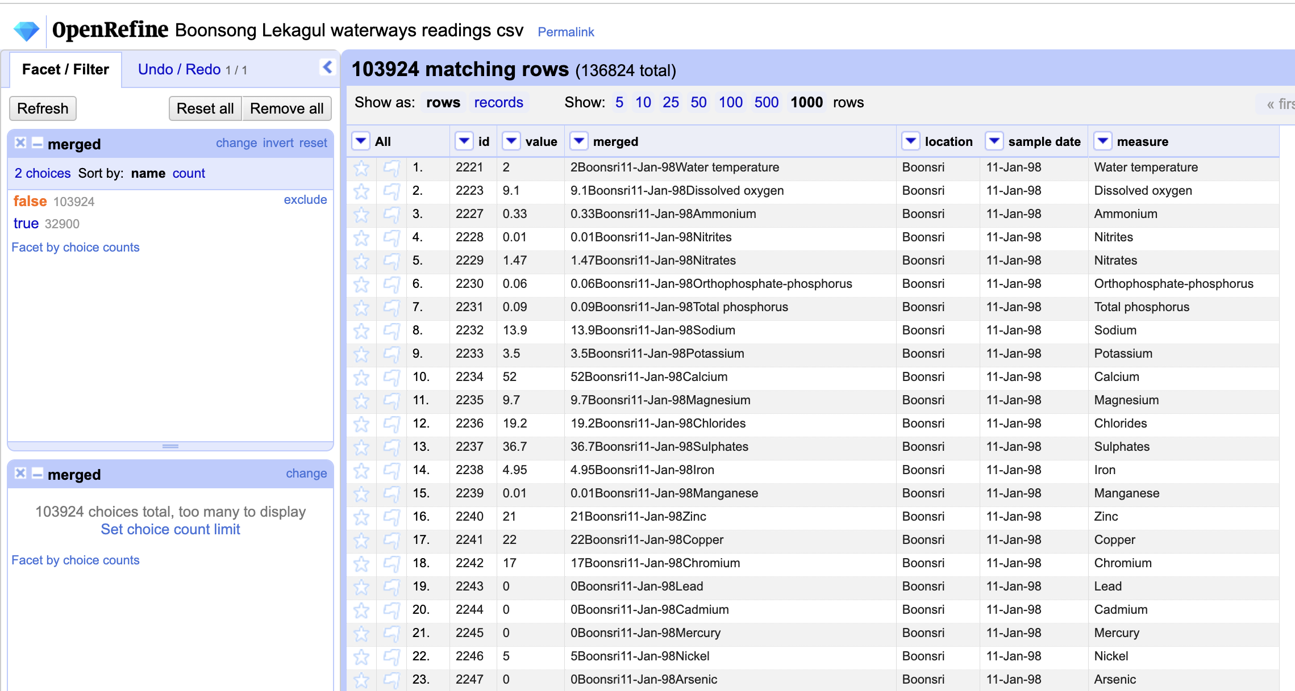
Duplicate Values

Slide 4
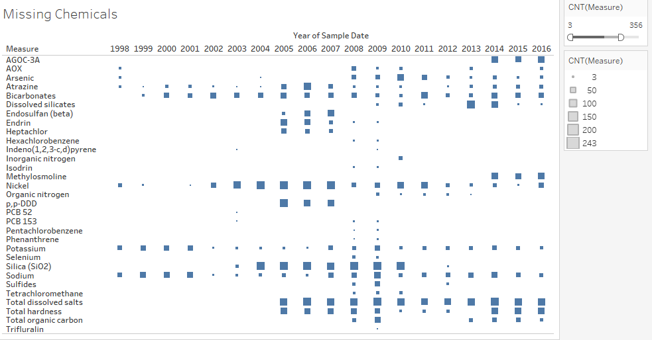

Slide 5
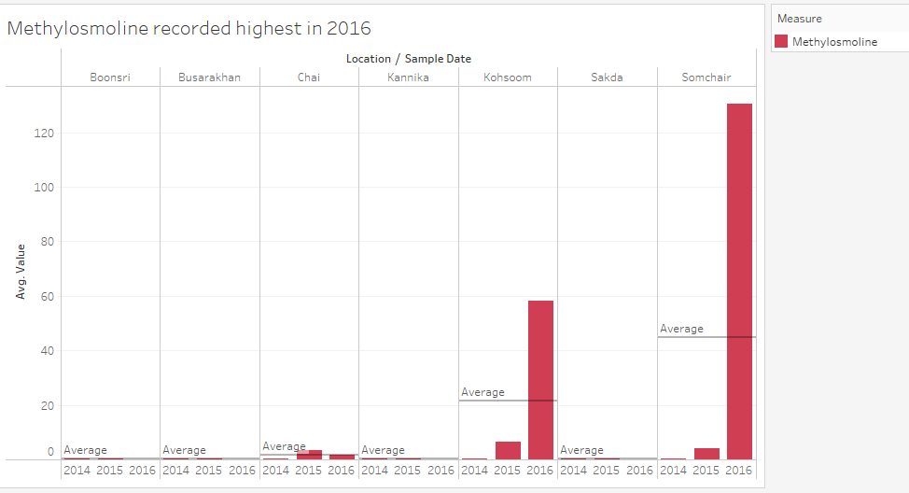
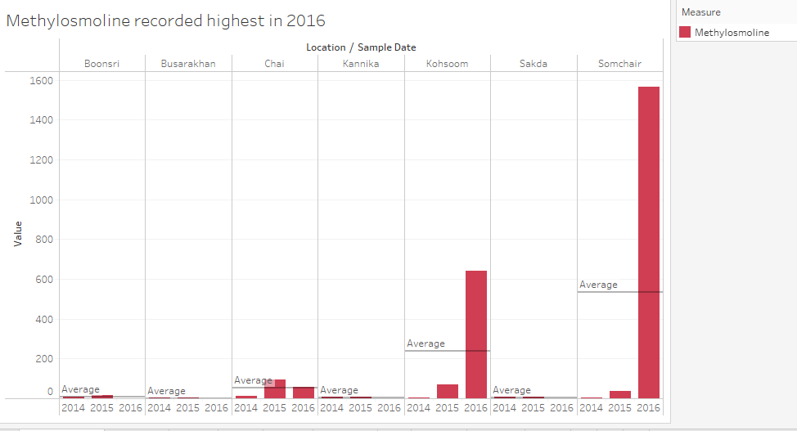
Notes:
Recorded only after 2014
Present more in Somchair followed by Kohsoom and Kannika
Similar trend observed in Boonsri, Busarakhan, Kannika and Sakda

Slide 6
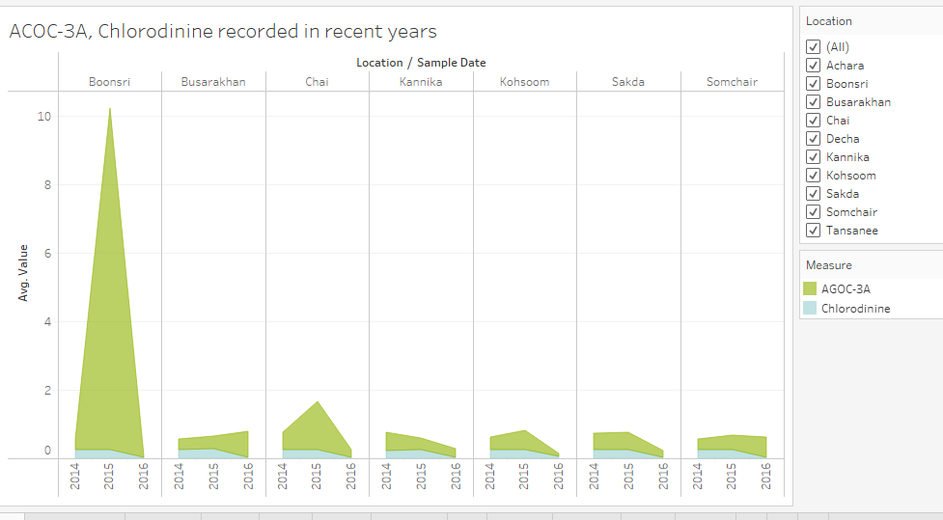
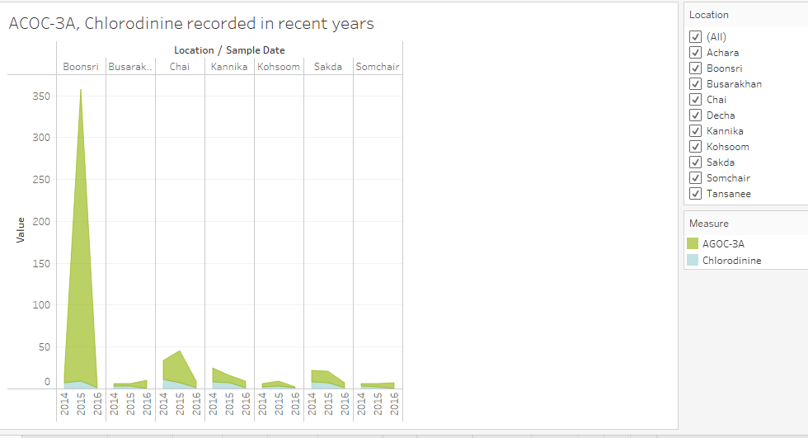
Notes:
Recorded only after 2014
Present more in Boonsri followed by Chai, Kannika and Sakda
Similar trend observed in Busarakhan, Kohsoom and Somchair

Slide 7
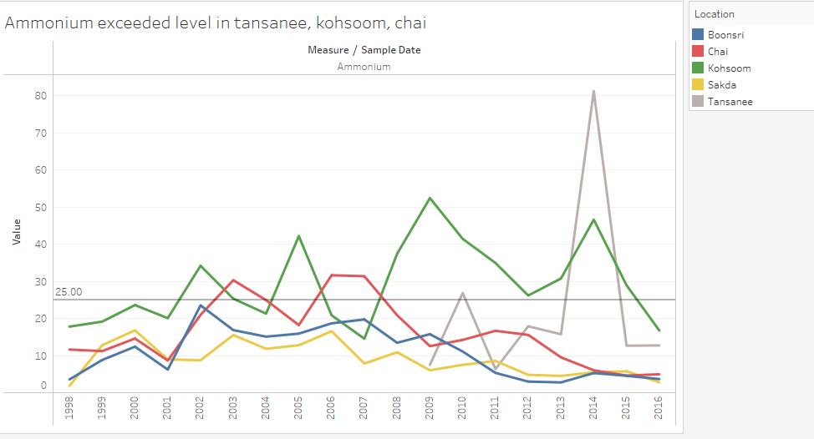
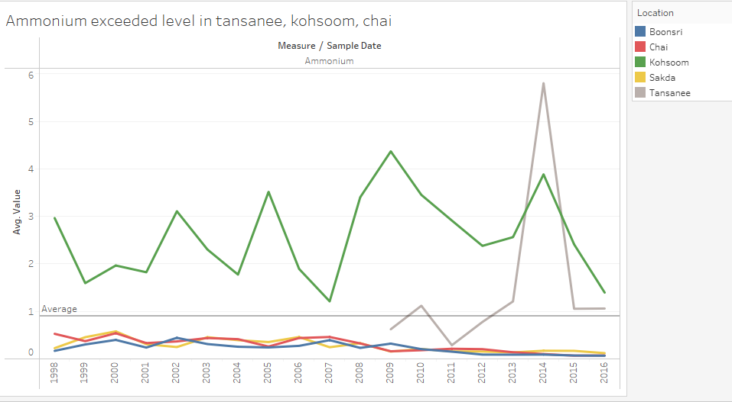
Notes:
High concentrations of ammonium can cause respiratory distress in birds and other wildlife.

Slide 8
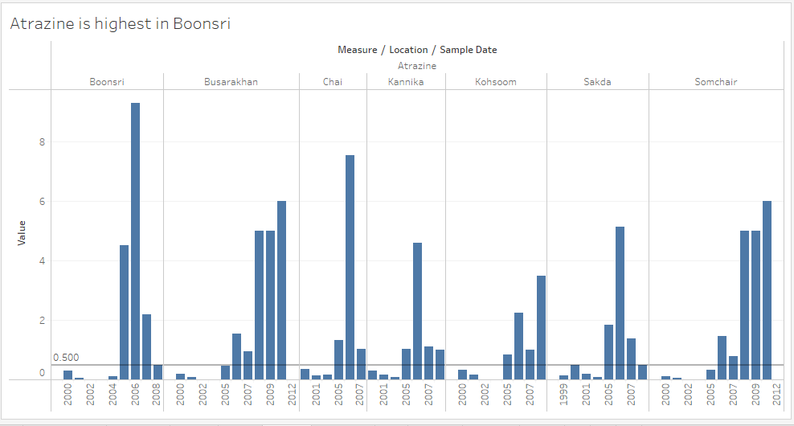
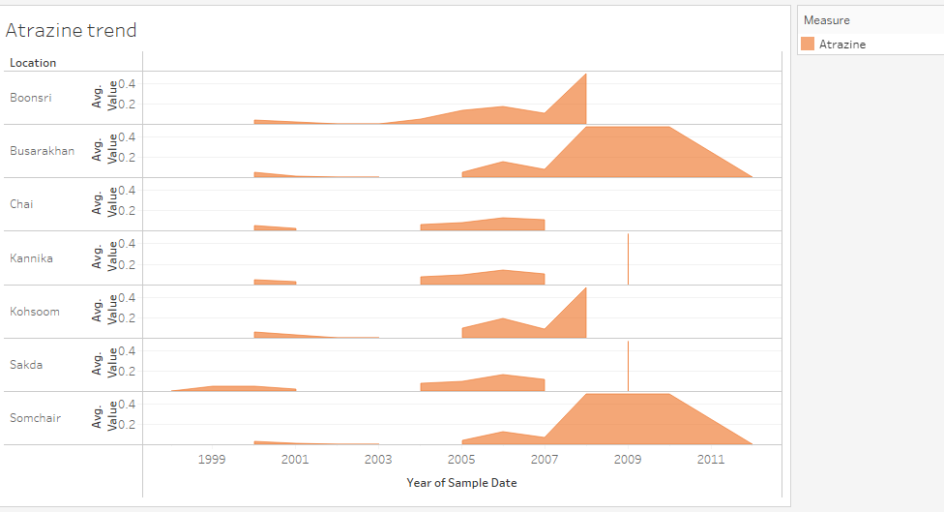
Notes:
Atrazine is an herbicide that can negatively impact bird reproduction, development, and survival

Slide 9
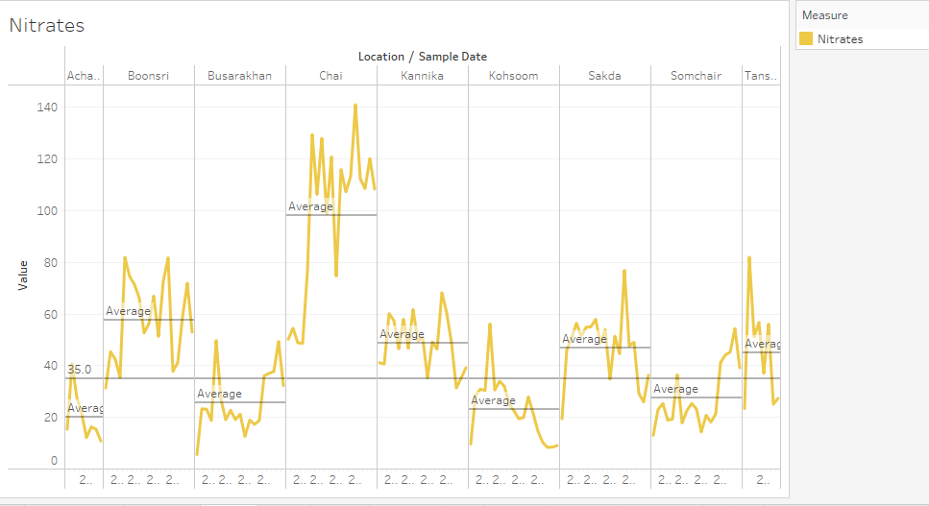
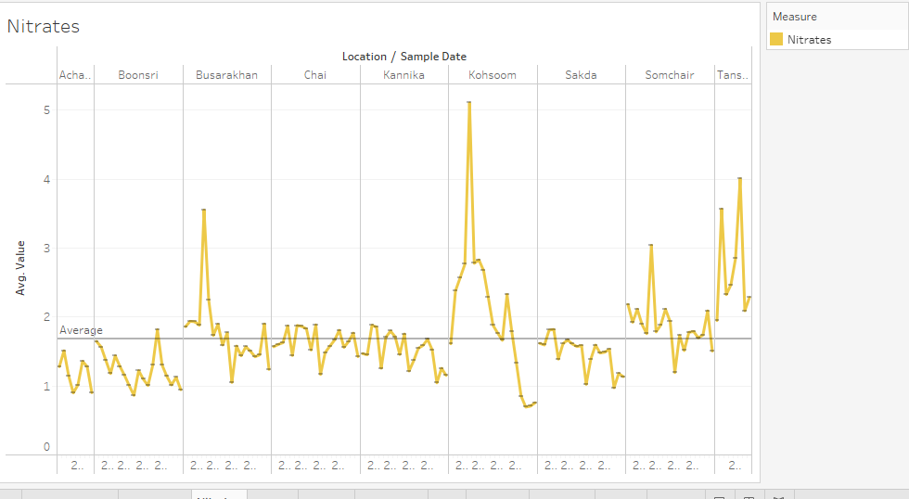
Notes:
High levels of nitrates can lead to methemoglobinemia, a condition where the blood cannot carry oxygen effectively.

Slide 10
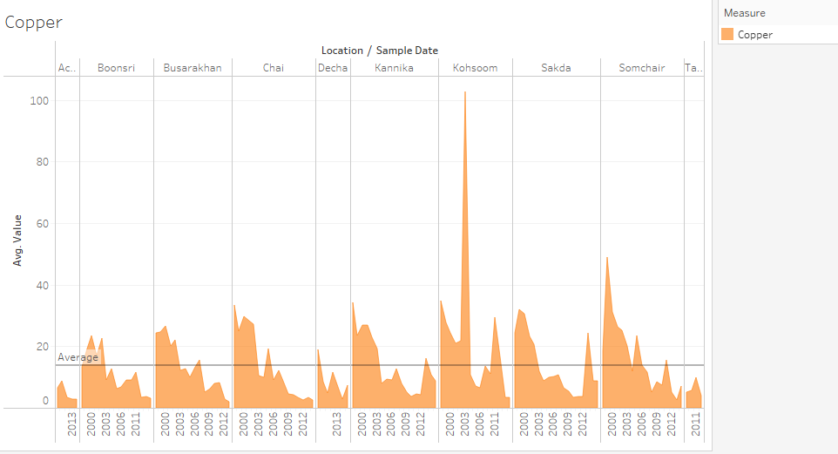
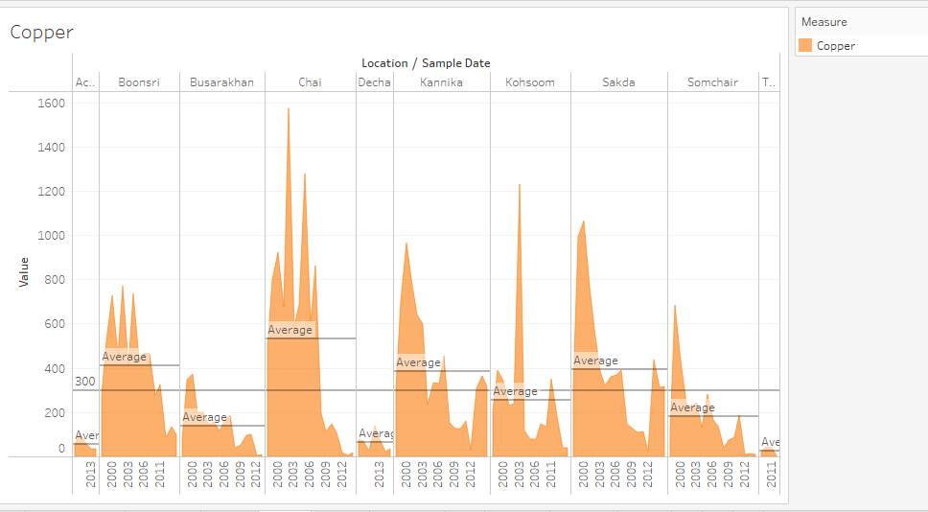
Notes:
Copper can be toxic to birds and other wildlife at high concentrations, leading to liver damage and other health issues.

Slide 11
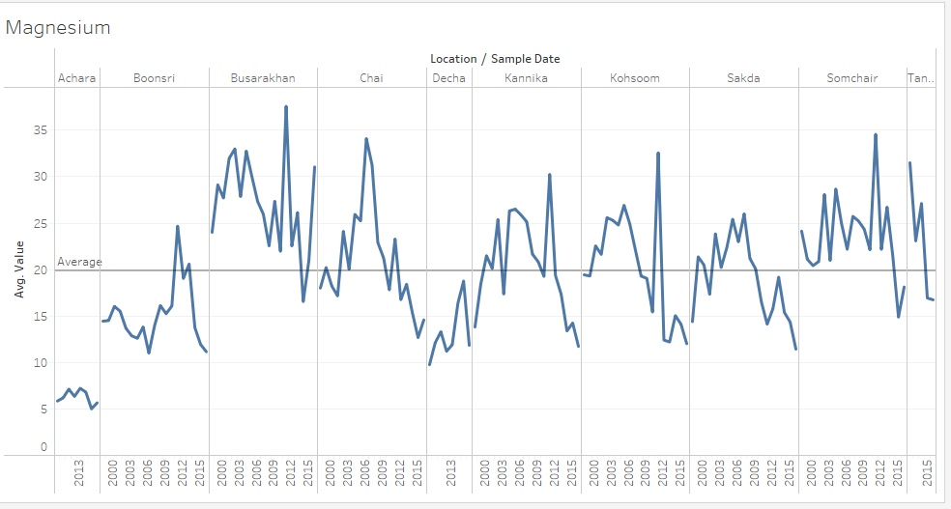
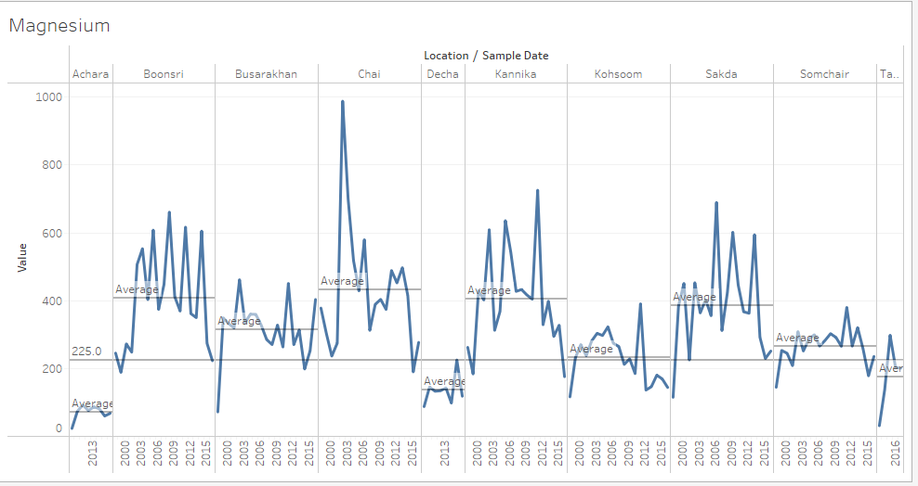
Notes:
Magnesium is generally not toxic to birds and wildlife but can cause digestive problems if ingested in large quantities.

Slide 12
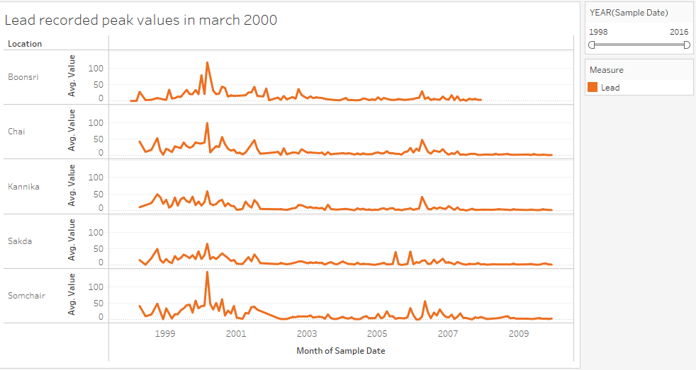
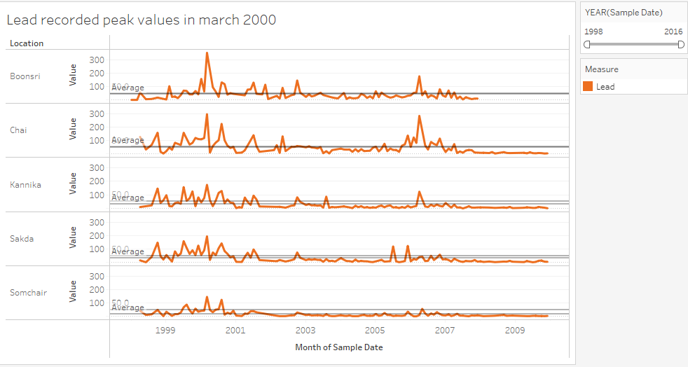
Notes:
Lead is highly toxic to birds and other wildlife and can cause neurological damage, reproductive problems, and death.

Slide 13
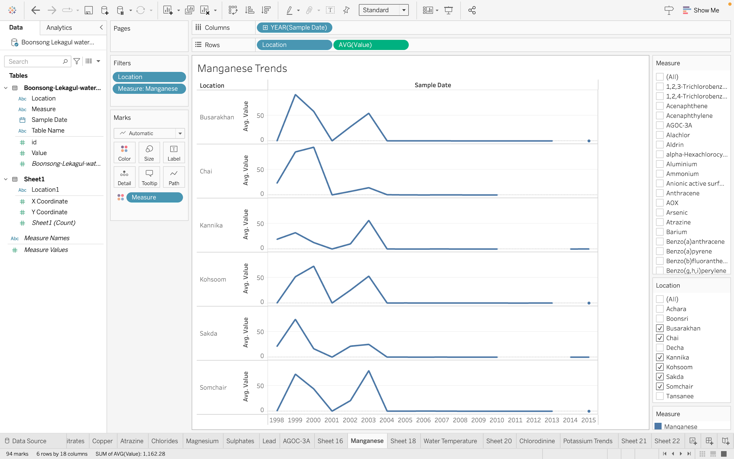
Notes:
High levels of manganese can negatively impact bird behavior and brain function.

Slide 14
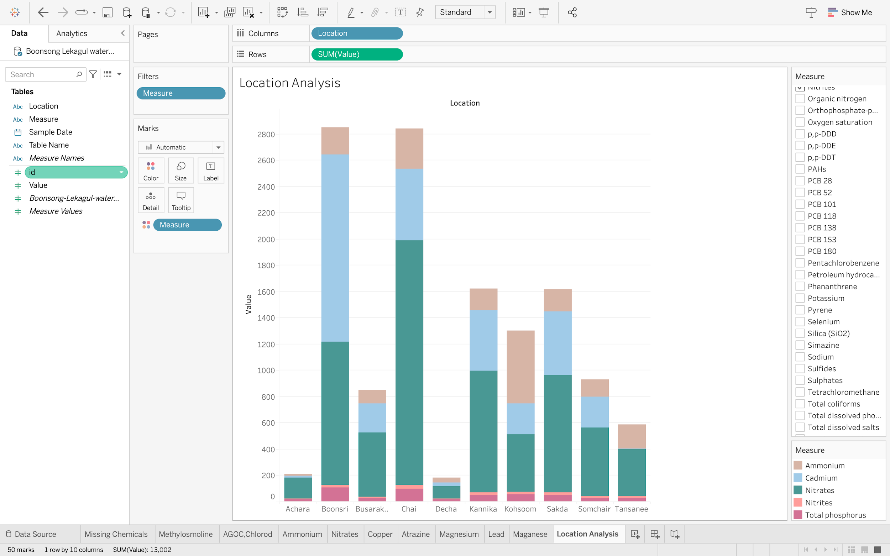
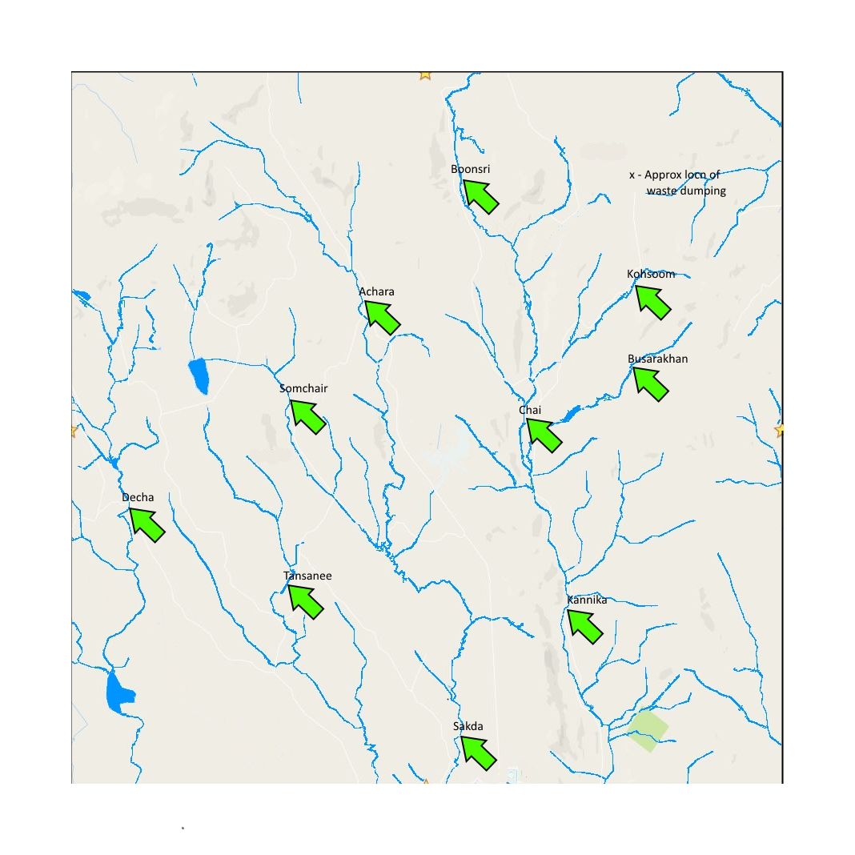
Possible Route
1
9
5
7
6
2
10
8
3
4

Slide 15
How do these affect your analysis of potential problems to the environment?
Missing Value: It affects the analysis since many chemicals can not be analyzed.
Duplicate data: The dataset has a duplicate record but can use an average to solve.
Is the Hydrology Department collecting sufficient data to understand the comprehensive situation across the Preserve?
The data has missing values for most of the chemicals and there are duplicates present as well. More data is required to for clear analysis.

Slide 16
What changes would you propose to make in the sampling approach to best understand the situation?
Regular collection of chemical values with accurate measurements is required.
Measures should be taken to eliminate redundant values.
The direction of the streams (upstream or downstream) is not mentioned in the dataset. Information on this front would be very useful as it would tell us about the spots where concentration might be higher and where it might be lower, assuming a dumping site was found.

Slide 17
Thank You

